Slide 1
American Corners

Slide 2
American Corner Addis Ababa Ethiopia

Slide 3
American Corner Almaty Kazakhstan

Slide 4
American Corner Baku Azerbaijan

Slide 5
American Corner Battambang Cambodia

Slide 6
American Corner Brasilia Brazil

Slide 7
American Corner Budapest Hungary

Slide 8
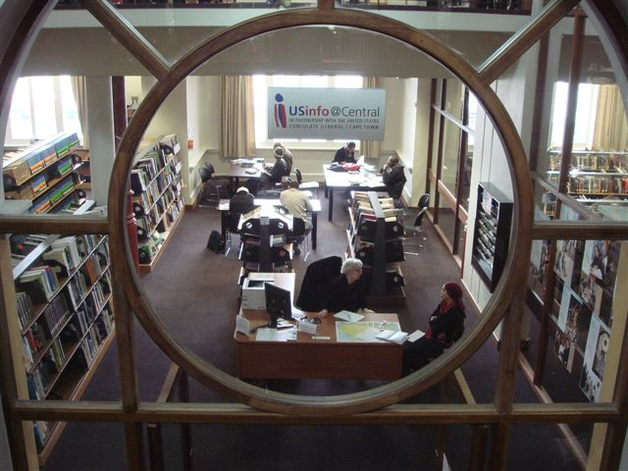
American Corner Cape Town South Africa

Slide 9
American Corner Constanta Romania

Slide 10
American Corner Dakar

Slide 11
American Corner Ziguinchor Senegal

Slide 12
American Corner Jalalabad Afghanistan

Slide 13
American Corner Jerusalem

Slide 14
American Corner Kampong Cham - Cambodia

Slide 15
American Corner Karaganda Kazakhstan

Slide 16
American Corner Kisumu Kenya

Slide 17
American Corner Limon Costa Rica

Slide 18
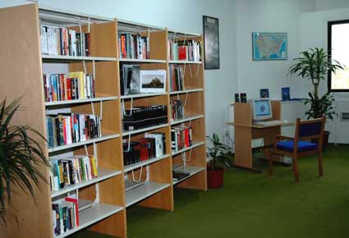
American Corner Nicosia Cypress

Slide 19
American Corner Oran Algeria

Slide 20
American Corner Pemba Nigeria

Slide 21
American Corner Quito Ecuador

Slide 22
American Corner Turkmenabat Turkmenistan

Slide 23
American Corner Vientiane Laos

