Slide 1
Sister Libraries: International Ties for Local Libraries
Carol Brey-Casiano
Information Resource Officer, Dept. of State
Past-President, American Library Association

Slide 2
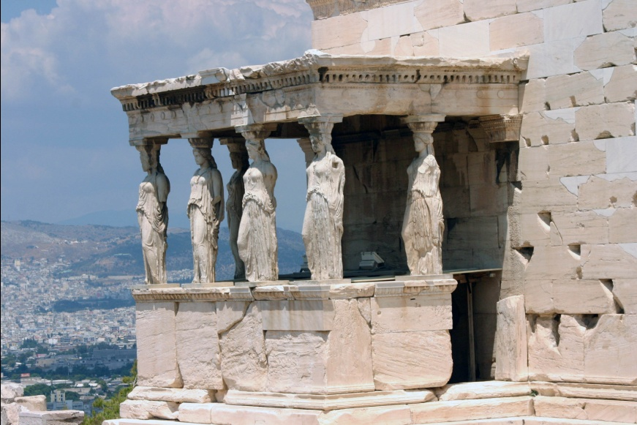
A Conversation at the Athens Municipal Library, Greece
Notes:
It was June, 2006 and I was visiting the Athens Municipal Library in Greece. In a conversation with the Library Director and other municipal officials, I was asked, “How could we find a Sister Library? Our library usage is growing, and we could really benefit from the experience of a library in the United States.”
This was a question I had answered many times as President-Elect and President of ALA, during my travels internationally to represent ALA. I gave my usual answer to the municipal official in Athens, noting that ALA has a Sister Libraries program, and they would be happy to work with Athens to identify a sister library in the U.S. (particularly if it involved any travel to Greece!) Even though I was proud of what ALA had accomplished with the Sister Libraries program, I knew that the program needed additional resources in order to build on its earlier success and truly reach the many libraries internationally that were looking for a sister libraries relationship with U.S. libraries.

Slide 3
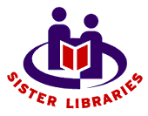
The Sister Libraries Program
ALA President Sarah Long gives the program a strong start in 1999.
ALA President Carol Brey-Casiano provides funds from her presidential budget in 2005 for the Sister Libraries program, used to :
Update the Sister Library brochures in English and Spanish --later translated into multiple languages
Fund research to provide information on the U.S. State Department American Corners and their possible connections with U.S. cities.
http://wikis.ala.org/sisterlibraries/index.php/Main_Page
Notes:
I provided $5,000 which was used to update the sister library brochures in English and Spanish. Until then we were still using the initial brochures created under Sarah Long which were old and out of date. I've attached the Spanish brochure as an example.
The remaining funds were used to fund research on the American Corners and their possible connections with U.S. cities. So this information is now on the main page of the Sister Libraries Wiki under Cities with American Corners, US-based populations and US Libraries.

Slide 4
Benefits of the Sister Libraries Program
Raise awareness of issues and needs facing libraries internationally
Offer opportunities to learn more about a region or country represented by an immigrant group in the community
Share techniques and technologies to help solve problems
Broaden the Library staff’s view of the library profession
Increase staff and community knowledge of other cultures
Share information, resources, expertise, and training between libraries
Notes:
From the Sister Libraries brochure--

Slide 5
ALA / IRRT Sister Library Initiative
Visit the ALA website to:
View the Sister Library Brochure in multiple languages
Read Sister Library success stories
Look at the Advance Planning Checklist
Read suggestions on how to find a Sister Library
Browse The Directory of libraries seeking a Sister Library partnership
Notes:
ALA / IRRT Sister Library Initiative
From Sister Libraries
(Redirected from Main Page)
Jump to: navigation, search
To promote the concept of a global community of libraries, the American Library Association (ALA) is encouraging U.S. libraries to form partnerships with libraries in other countries. Participants in the ALA Sister Library Initiative should choose the level of involvement with their Sister Library based upon the mutual needs of the libraries. Sister Libraries should make commitments at levels that are comfortable for both participants. Some partnerships will be informal, while others may involve formal contracts and ceremonies. The links below will provide ideas and resources to help you arrange this type of partnership. Sister Library Brochure Contains helpful tips and an overview of the Sister Library program. Sister Library Brochure
Sister Library Brochure in Arabic (بالعربية)
Sister Library Brochure in Russian (Русский)
Sister Library Brochure in Ukrainian (Українська)
Sister Library Brochure in Traditional Chinese (繁體中文)
Sister Library Brochure in Simplified Chinese (简体中文)
View our 2010 ALA Annual Program
Wondering what it's like to be in a Sister Library partnership?
Check out our success stories.
Take a look at a few reasons why you might want to become a Sister Library.
Ready to get involved?
First read over our advance planning checklist for suggestions of things to consider before contacting a potential library.
Then read our suggestions on how to find a Sister Library. Explains how to use this website to connect with international libraries, and also lists many other excellent opportunities.
Browse The Directory of libraries seeking a Sister Library partnership.
The newest additions are listed together.
Browse all listings

Slide 6
Sister Library Success Stories
Des Plaines Public Library and the Biblioteca Benjamin Franklin in Zapopan, Mexico outside Guadalajara
Two staff exchanges
Children’s book exchange
Children’s artwork exchange
Appalachian State University (Boone, N.C.) and La Biblioteca Th'uruchapitas (Cochabamba, Bolivia)
Notes:
First we hosted a librarian from the Biblioteca Benjamin Franklin for one week. Our visiting Mexican librarian observed public service desks, attended meetings, and acquired a small taste of Chicago and American public libraries to share with his colleagues back home. In April 2008 one of us spent one week in Mexico immersed in Mexican culture. She toured rural and city libraries (public, academic, special) in the Guadalajara region and spent several days learning how the unique Biblioteca Benjamin Franklin operates.
Children’s book exchange: We selected Spanish translations of popular & classic American children’s books, labeled them with our library bookplates, and mailed the package to our Sister Library’s tiny children’s section. Our goal was to share a typical American child's experience.
Children’s artwork exchange: We held a Youth Services program where children made collage drawings illustrating themselves and their families. We attached a photo of each child to the art. We then hand-delivered the pictures on our next book-buying trip to Mexico. In exchange, our Sister Library gave us a selection of artwork made by their local children, which we will soon display. We wanted to bring our patrons directly into the Sister Library project and thought children would be the best voices of culture. We hope that ultimately our children and their Mexican peers will learn about each other's lives and culture.
The relationship between Appalachian State University (Boone, N.C.) and la Biblioteca Th'uruchapitas (Cochabamba, Bolivia) began in 1998 when Gaby Vallejo, founder of la Biblioteca, came to Appalachian State University to speak about her innovative children's library program. The program caught the ear and the heart of ASU Library Science professor, Linda Veltze. A conversation began between the two women that evolved into a more substantial relationship when the two institutions became Sister Libraries through the White House Millennial Commission (since defunct) in 2000. The success of this particular Sister Library project has been internationally recognized, receiving the IBBY Asahi Reading Promotion Award in 2003.
In a country that has little money for books, la Biblioteca Th'uruchapitas is the only library in Bolivia that provides picture books and literature to children. La Biblioteca is staffed solely by volunteers, headed by Gaby and a group of dedicated educators who proudly bear the title "las mujeres peligrosas" (dangerous women) due to their progressive ideas about education.
In recent years, ASU and la Biblioteca have worked together in numerous projects. La Biblioteca has hosted several groups of ASU students and scholars who traveled to Bolivia for a number of reasons: conducting research; working on international service projects; or taking study-abroad courses for credit. In turn, Gaby and several "dangerous women" have visited Appalachian's campus and the surrounding community of Boone, speaking about the economic, educational, and social realities of Bolivia. In so many ways this Sister Library project has affected the lives of librarians, educators, students, and community members from both countries. In summary, our status as Sister Libraries continues to be a source of pride, opportunity, and inspiration for both institutions.

Slide 7
The Future of Sister Libraries—Going Strong!
Low/no-cost projects
Skype chats
Creating a Flickr "postcard" photo album with pictures taken by both libraries
International Library Snapshot Day –
April 2012
Exchanges
Ideas
Resources
Staff
University of Cordoba, Argentina Library

Slide 8
Questions & Answers
Library of Catalán, Barcelona

Slide 9
Contact Carol Brey-Casiano cbrey75@hotmail.com

